Slide 1
Life Sciences Advisory & Deal Execution Platform strategy
Ideas for today and tomorrow…

Slide 2
Agenda
About us our Platform
Product overview
Market overview
Growth strategy
Summary

Slide 3
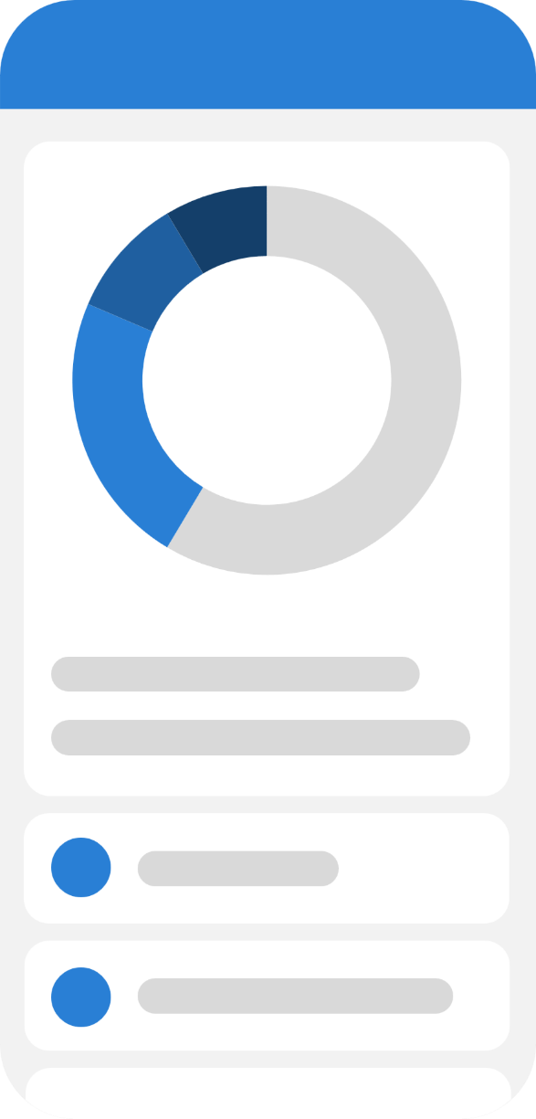
An Advisory & Deal Platform designed for:
Pharmaceutical companies
Biotechnology firms
Healthcare Associations and Professionals
CDMOs
CROs
Medical device companies
Private equity
Venture capital
“Aiming to revolutionize industries through our forward-thinking solutions”

Slide 4
Product overview
Combining functionality and user-friendliness, we empower users to streamline operations and boost efficiency

Slide 5
Product benefits:
Increased productivity
Seamless integration
Enhanced user experience
Scalability for future growth
User-friendly learning

Slide 6
Core Modules
Customer Intelligence
Expert Database
Project Workspace
Deal Pipeline
Document Intelligence

Slide 7
Customer Intelligence –”Much more than contacts”…
Companies
Investors
Portfolio companies
Manufacturing sites
FDA inspection history
Technologies
Products
Therapeutic areas
Decision makers
Previous engagements
Deal history

Slide 8
Customer Intelligence – Example “Pfizer”…
Contacts
Projects
Products
Facilities
Experts used
Past proposals
Open opportunities
Inspection history
Documents

Slide 9
Expert Database – “Instead of employees” track...
Subject matter experts
Consultants
Board advisors
Former FDA reviewers
Former pharma executives

Slide 10
Expert Database – For each expert, track...
Expertise
Therapeutic areas
Countries
Languages
Availability
Hourly rate
Publications
Previous projects

Slide 11
Project Workspace – “Each engagement becomes its own workspace”…
Project
Client
Objectives
Timeline
Milestones
Deliverables
Experts
Documents
Meetings
Budget
Risks
Invoices
Final report

Slide 12
Deal Pipeline – “Most CRMs stop at opportunities”, we manage…
Lead
↓
Opportunity
↓
Proposal
↓
Due Diligence
↓
LOI
↓
Technical Review
↓
Commercial Review
↓
Quality Review
↓
Risk Assessment
↓
Closed
↓
Execution

Slide 13
Document Intelligence – store…
SOPs
Reports
FDA letters
Audit findings
Validation reports
Presentations
Contracts

Slide 14
AI Features – Instead of generic AI, we offer “Life Sciences AI”...
Proposal Generator - "Generate a proposal for CMC consulting."
Expert Finder - "Find experts with sterile manufacturing and FDA remediation experience."
Risk Scanner – Upload:
    Quality reports
    Audit reports
  AI identifies
    Major findings
    Compliance risks
    CAPAs

Slide 15
AI Features – Instead of generic AI, we offer “Life Sciences AI”(cont.)...
Due Diligence Assistant - Upload Confidential Information Memorandum (CIM) AI generates:
Red flags
Questions
Risks
Executive summary
Meeting Assistant – AI Automatically produces:
Minutes
Action items
Next steps
Client emails

Slide 16
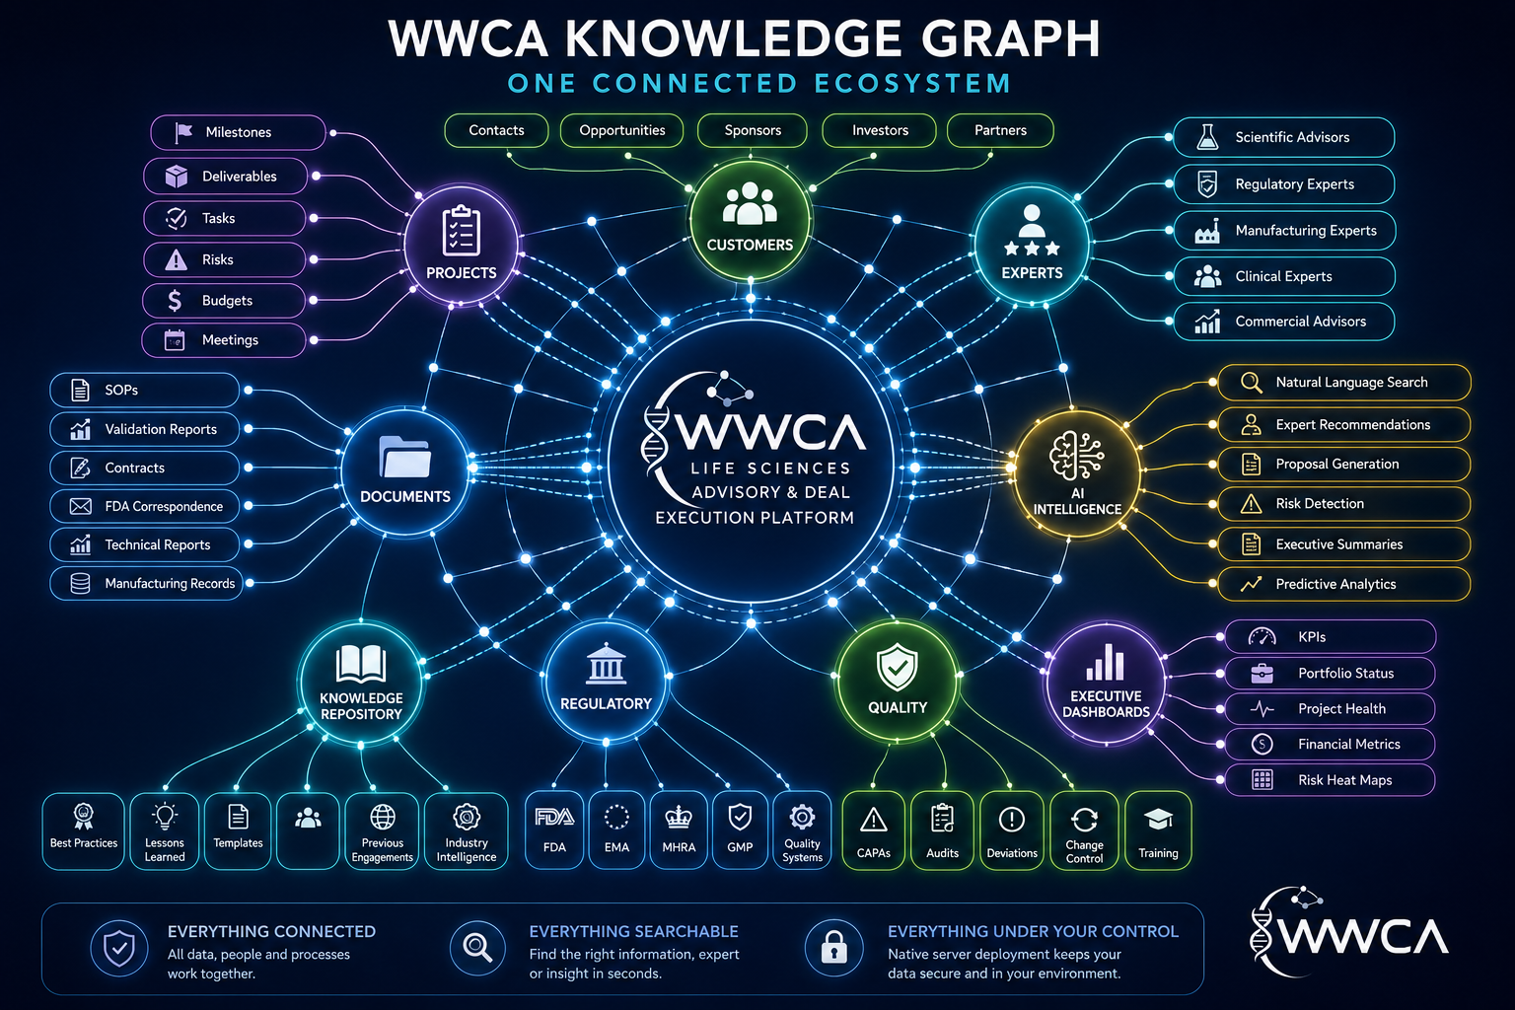
Knowledge Graph – “Connect everything”…

Slide 17
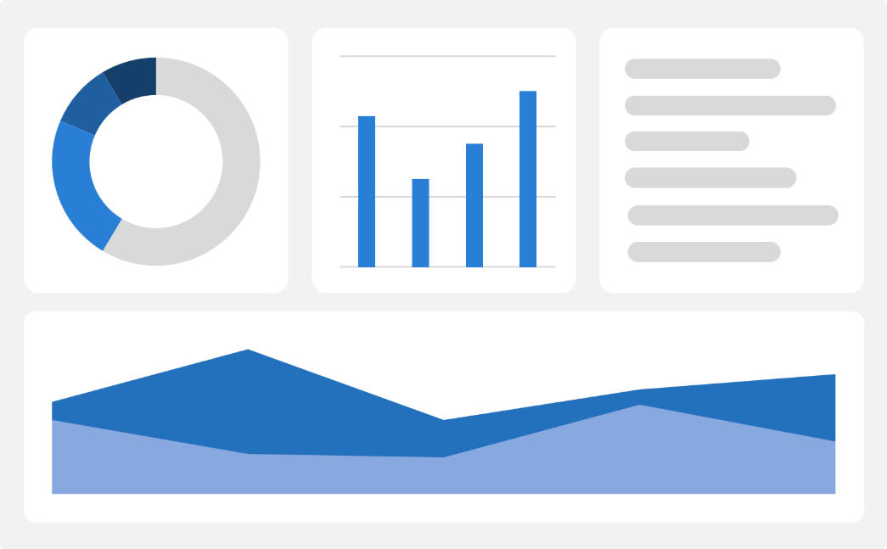
Market comparison
Stands out in market
Innovative features
Provides unique solution
Edge over competitors
User-focused design
Prioritizes user experience

Slide 18
Competitive landscape
Strong market presence
Positioned as a market leader
Leveraging a robust infrastructure
Dedicated team of experts
Outperforming competitors
Good brand name recognition
More agility and adaptability
Stronger competitive edge
Ability to adapt swiftly
Stay ahead of the curve
Continuously improve offerings
Integrate user feedback

Slide 19

Competitive Advantages:
General CRMs know little about regulated life sciences. WWCA platform includes:
Contact | Organization profile with products, facilities, and regulatory history
Opportunity | Drug development program
Task | Regulatory milestone
Notes | Scientific knowledge base
Files | Structured technical document repository
Dashboard | Development and compliance dashboard
AI | Drug development and regulatory AI
Users | Experts and advisors
Reports | Diligence and regulatory reports

Slide 20
Competitive Advantages:
Additional Modules…
Expert marketplace
Board management
Advisory council management
Due diligence workspace
Manufacturing readiness tracking
Regulatory submission tracker
Technology scouting
Licensing opportunity tracker
Partner portal
Secure client portal

Slide 21
Revenue Model - Rather than selling "software," package the platform with services.
Level | Services
Tier 1 – CRM | Customer management Pipeline Contacts
Tier 2 – Project Management | Milestones Tasks Documents Collaboration
Tier 3 – Advisory Platform | Expert database AI matching Proposal automation Reporting
Tier 4 – Investor Suite | Due diligence IC reports Portfolio monitoring Risk scoring
Tier 5 – Enterprise | Custom workflows APIs Single sign-on (SSO) Audit logs Validation documentation

Slide 22
Revenue Model – Tier Level Pricing Strategy
Level | Features | Cost to Customer
Tier 1 – Client Portal (For existing consulting clients) Target: Small biotech, startups | Secure client portal, Project dashboards, Document sharing, Milestones, Messaging, Meeting notes, Basic reporting | $250–$500/month
Tier 2 – Professional Target: Growing biotech, CDMOs, CROs | CRM, Unlimited projects, Expert directory, AI document search, Proposal generation, Workflow automation, Executive dashboards, Up to 15 users | $1,500–$3,000/month
Tier 3 – Enterprise Target: Mid-size pharma, large CDMOs, medical device companies | Unlimited users, Multi-site management, Advanced AI, Regulatory tracking, Resource planning, Portfolio management, API integrations, SSO, Audit logs, Custom workflows | $5,000–$10,000/month
Tier 4 – Investor Suite Target: Private equity, venture capital, family offices | Due diligence workspaces, AI red-flag analysis, Investment committee reports, Portfolio monitoring, Deal pipeline, Risk scoring, Expert matching | $10,000–$25,000/year (or bundled into diligence engagements)

Slide 23
Revenue Model – Add-On Services Pricing Strategy
Service | Cost to Customer
AI Proposal Generation | $500/month
Expert Marketplace Access | $1,000/month
AI Technical Document Review | $750/month
Regulatory Intelligence | $1,500/month
Custom Dashboards | $5,000 setup
Data Migration | $5,000–$25,000
Custom Integrations | $10,000–$50,000
Training & Onboarding | $2,500–$10,000

Slide 24
Revenue Model – Bundle With Consulting Pricing Strategy
Consulting Engagement
CMC Strategy Project
Consulting Fee: $75,000
Platform Access: Included for 6 months
AI Reports: Included
Client Portal: Included
Executive Dashboard: Included
After the engagement:
Continue access for $1,500/month to:
Review past projects
Search documents
Reuse templates
Collaborate on new initiatives

Slide 25
Revenue Model – Annual Subscription Packages
Plan | Annual Price | Ideal Customer
Starter | $6,000 | Early-stage biotech
Professional | $24,000 | Small-to-mid biotech, CDMOs
Business | $60,000 | Commercial-stage companies
Enterprise | $120,000+ | Global pharma, large manufacturers
Investor | $25,000–$100,000 | PE/VC firms

Slide 26
Growth strategy
Expand
Foster collaborative
growth
Enhance
Ensure a tailored and user-focused experience
Explore
Capitalize on emerging global markets
Expand market reach through strategic partnerships
Enhance product features based on user feedback
Explore international market opportunities

Slide 27
Traction
Product launch
  Successful introduction of our product to market
1000+ user milestone
  Substantial user base, indicating growing demand
Strategic partnership
  Expanding market presence and capabilities
Milestone | Quarter
Product launch | 2026 Q3
1000 user milestone | 2026 Q4
Strategic partnership | 2027 Q1
Campaign launch | 2027 Q2

Slide 28
Summary
Long-Term Vision
The strongest competitive position is to become the operating system for life sciences advisory and transactions, not another horizontal CRM.
That means one platform where a client can:
Manage relationships with sponsors, CDMOs, CROs, and investors.
Build and execute consulting engagements with structured project workspaces.
Search a curated network of scientific and operational experts.
Track regulatory milestones, quality events, and commercialization activities.
Store and retrieve institutional knowledge from reports, SOPs, contracts, and diligence documents.
Use AI to accelerate proposal creation, expert matching, technical reviews, and due diligence.
Strong market positioning
Robust growth strategy
Innovative product development
Commitment to user satisfaction

Slide 29
Thank you
Charles Hauswald
(484) 447-2136
charles@wwcassociates.net
www.wwcassociates.net

